Slide 1

ENT AI Diagnostic
This presentation outlines the development of an innovative machine learning website designed to assist ENT professionals and patients.
Team Members:
2210030369: Tetala Meghana Reddy
2210030380: Chandra Chinmayee
2210030379: Varla Sai Tejartha Reddy
2210030416: B Anushka
Under the guidance of
"Dr. Sumit Hazra"

Slide 2
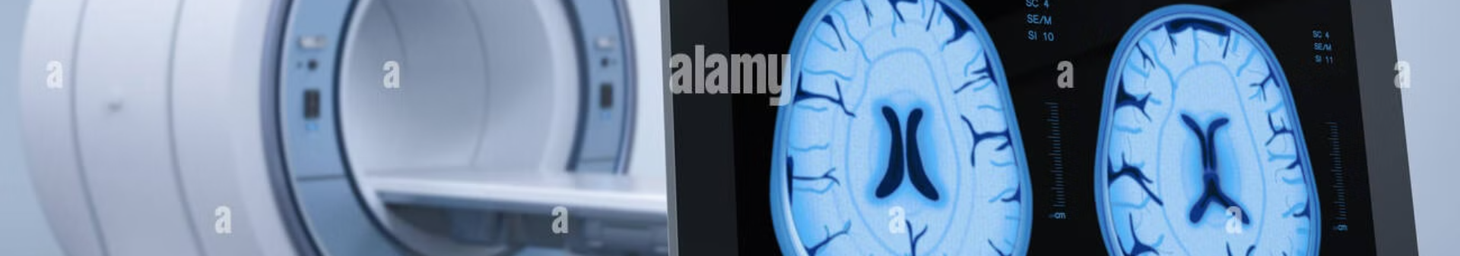
Problem Statement
Enhancing ENT Disease Detection Using Artificial Intelligence on Medical Images
The goal of this project is to develop a web-based platform, "ENT AI Diagnostic," that leverages machine learning algorithms to analyze medical images and accurately identify Ear diseases.

Slide 3
Dataset
EAR Images
NOSE Images
THROAT Images
A diverse collection of Ear images, including normal ear and other kind of diseases.
A diverse collection of Nose images, including normal nose and other kind of diseases.
A diverse collection of Throat images, including normal throat and other kind of diseases.

Slide 4
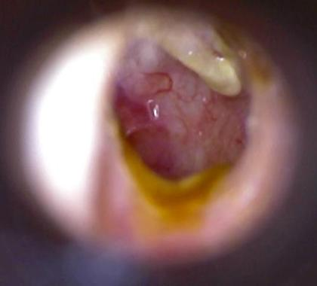
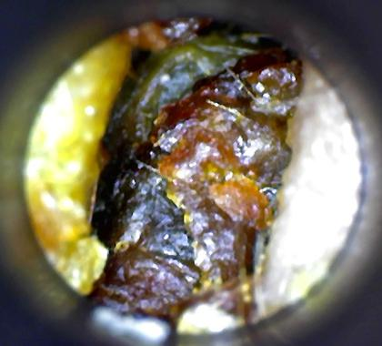
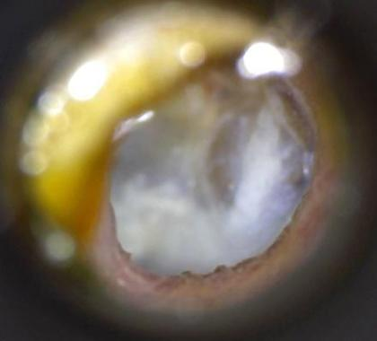
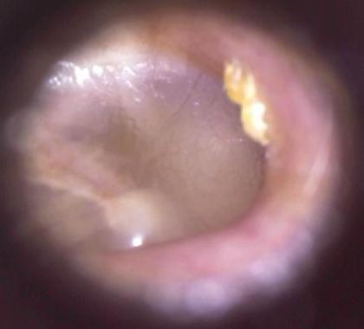
SNO | Disease | Image Count | Image sample | Symptoms
1. | Chronic otitis media | 180 |  | .Hearing Loss .Ear Discharge .Ringing in ear .Ear redness
2. | Earwax plug | 180 |  | .Hearing loss .Pressure in ear .Itching in ear .Discharge
3. | Myringosclerosis | 180 |  | .Hearing Loss .Ear drum is white .Ringing and Fullness
4. | Normal | 180 |  | .Clear Hearing .No Ringing .No Itching and redness .No Pain

Slide 5


Existing Systems
1
Image Recognition Software
Existing image recognition software focuses on general medical imaging, but lacks specialized ENT capabilities.
2
Telemedicine Platforms
Telemedicine platforms provide remote consultations, but often lack advanced diagnostic tools.
3
ENT Databases
Limited publicly available ENT databases exist, hindering the development of robust machine learning models.

Slide 6
RESEARCH PAPERS
TITLE OF PAPER | LINK FOR THE PAPER
Classical approaches and new deep learning trends to assist in accurately and efficiently diagnosing ear disease from otoscopic images | https://ieeexplore.ieee.org/document/10323057
Artificial Intelligence With Deep Learning Based Automated Ear Infection Detection | https://ieeexplore.ieee.org/document/10487914
Ear disease detection using R-CNN | https://ieeexplore.ieee.org/document/9913612
Artificial Intelligence-Driven Advancements in Otitis Media Diagnosis: A Systematic Review | https://ieeexplore.ieee.org/document/10599254
Hands-on Practice and Implementations on Intemet-Based Remote ENT Diagnosis Systems | https://sci-hub.st/10.1109/icmech.2005.1529334

Slide 7
Literature Survey
Date | Title | Techniques | Results | Advantages | Limitations
02 April 2024 | Artificial Intelligence With Deep Learning Based Automated Ear Infection Detection | BODL-AEIDC algorithm. . Image Pre-Processing -wiener filtering technique . W-Net Based Segmentation -W-Net model . Efficientnet Feature Extraction -EfficientNet model . Ear Infection Detection Using the FRBM Model . Hyperparameter Tuning Using BO Algorithm | The comprehensive comparison study stated the enhanced performance of the BODL-AEIDC technique over other methods. The performance of the proposed work yields a better level of accuracy with 98.65%, 97.92% of precision, 98.65% of recall and 98.25% of F score. | The existing methodology of detecting the ear infection experiences a reduction of accuracy due to the influence of the noise in the input ear image. The comprehensive comparative study stated the enhanced performance of the BODL-AEIDC approach over other existing methods. | In the upcoming years, the performance of the BODL-AEIDC algorithm can be enhanced with the feature fusion-based DL models.

Slide 8
Explanation of techniques and dataset used in all 5 papers
Paper | Techniques | Datasets
Classical approaches and new deep learning trends to assist in accurately and efficiently diagnosing ear disease from otoscopic images | DL concepts such as Transformers and ML models were used | Ear diseases otoscopic images
Artificial Intelligence With Deep Learning Based Automated Ear Infection Detection | BODL-AEIDC algorithm. | EAR DISEASES containing images
Ear disease detection using R-CNN | R-CNN algorithm | Eight types of ear disease
Artificial Intelligence-Driven Advancements in Otitis Media Diagnosis: A Systematic Review | Classical Machine Learning and Deep Learning Approaches | Medical Images of OM
Hands-on Practice and Implementations on Intemet-Based Remote ENT Diagnosis Systems | Techiniques are not that clear | Noise, images, video From patient

Slide 9


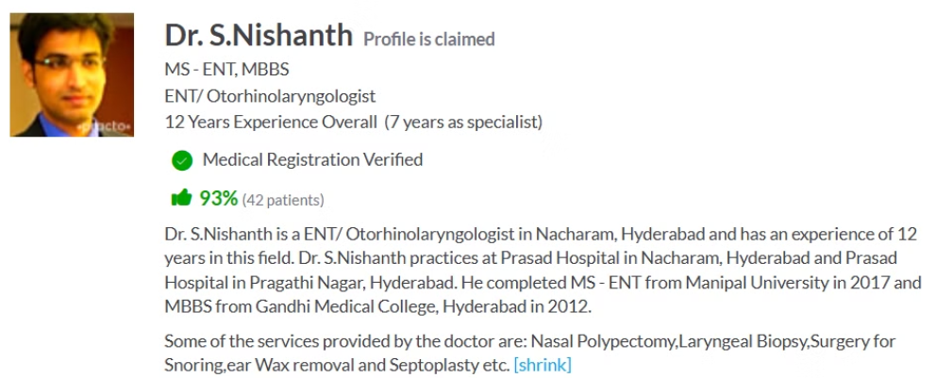
Details taken from Client

Slide 10
REFERENCES
https://datasetsearch.research.google.com/
Ear imagery database (figshare.com)
https://github.com/SarthakGarg19/OTOMYCOSIS/blob/master/images/otomycosis.jpg

Slide 11


